Slide 1
PC Maintenance: Preparing for A+ Certification
Chapter 8: Installing and Troubleshooting the Basic Components

Slide 2
Chapter 8 Objectives
Assemble the correct tools for PC building
Configure the motherboard
Install the CPU
Install the RAM
Install the motherboard in the case
Install the video card
Test the component installation

Slide 3
What You Need
Small Phillips-head screwdriver
ESD protection
Optional:
  Small flathead screwdriver
  Nut driver
  Other tools in a basic PC toolkit

Slide 4
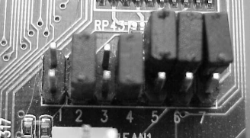
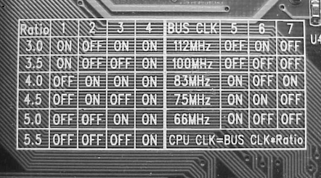
Configuring the Motherboard
Read manual
Set jumpers
Look for help on motherboard

Slide 5
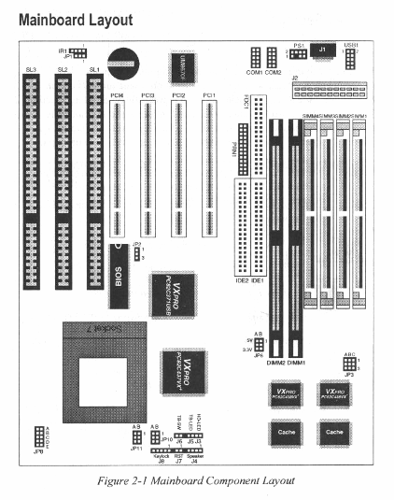
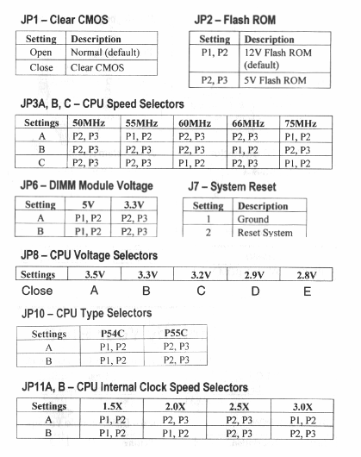
Example: Motherboard Manual

Slide 6
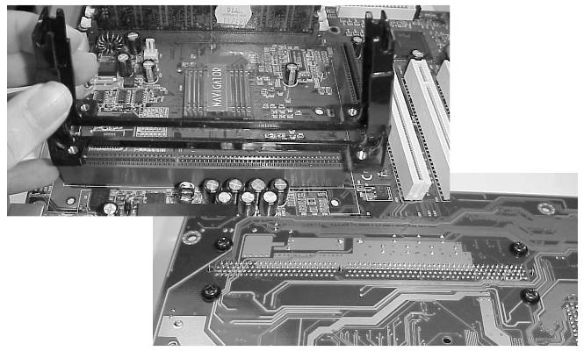
Installing an SEC CPU
Install support braces on motherboard

Slide 7
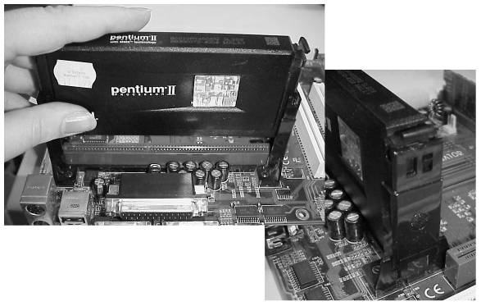
Installing an SEC CPU
Slide CPU cartridge into braces
Push to make sure fully seated

Slide 8
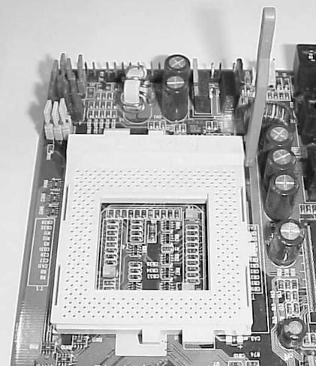
Installing a PGA CPU
Lift ZIF socket handle

Slide 9
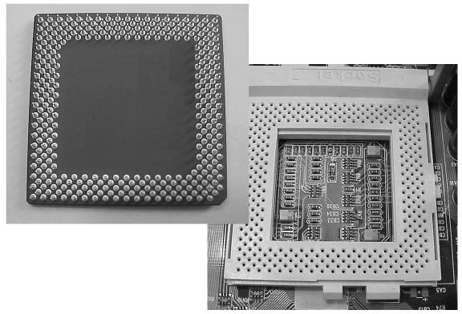
Installing a PGA CPU
Match up rounded corner on CPU to same on socket

Slide 10
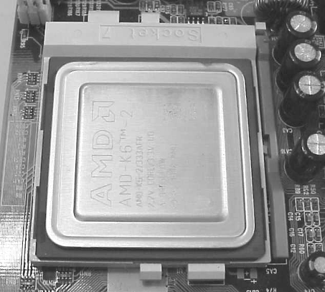
Installing a PGA CPU
Insert CPU
Lower handle
Double-check for correct orientation

Slide 11
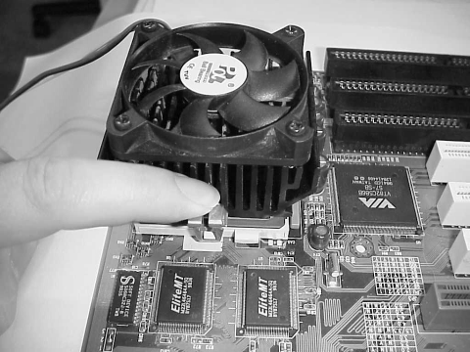
Active Heat Sink with Fan
Attach heat sink to CPU with clip

Slide 12
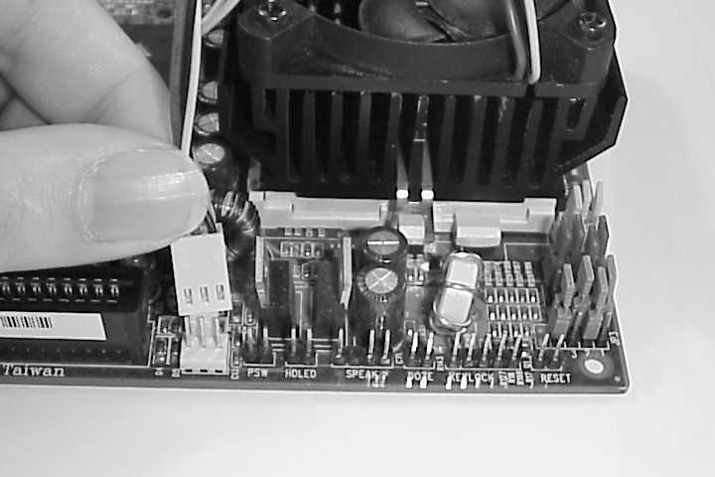
Active Heat Sink with Fan
Connect power cord for fan to motherboard

Slide 13
Passive Heat Sink
Apply thin layer of heat sink compound to heat sink
Adhere to CPU

Slide 14
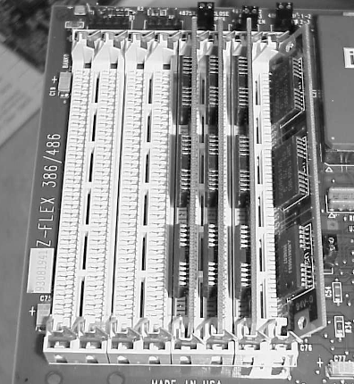
Installing SIMMs
Insert at angle
Tip up to lock into place
Tabs on ends lock when installed

Slide 15
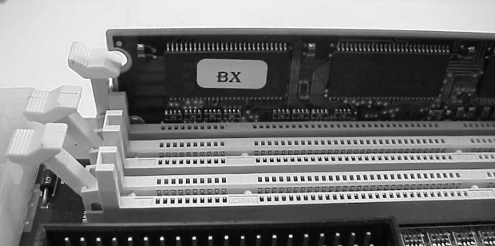
Installing DIMMs
Insert straight down
Press down into place
Tabs on ends lock when installed

Slide 16
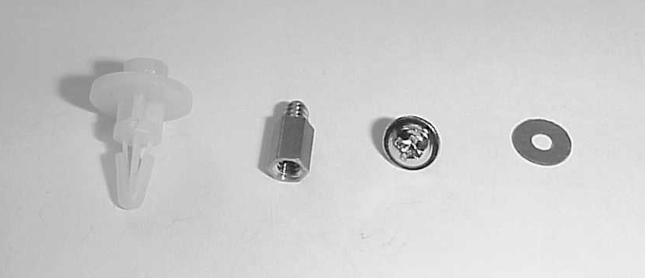
Installing Motherboard into Case
Prepare stand-offs
  Plastic: AT only
  Brass: AT and ATX

Slide 17
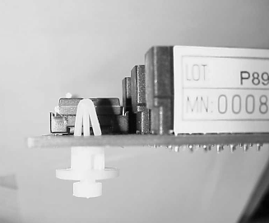
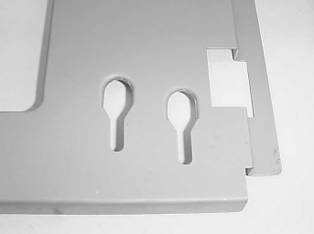
Plastic Stand-Offs
Fit into motherboard first
Then motherboard slides to lock stand-offs into channels

Slide 18
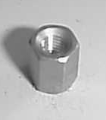
Brass Stand-Offs
Screw into case before motherboard goes in
Tops have threaded holes that are used for motherboard attachment

Slide 19
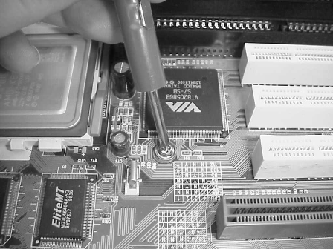
Installing Motherboard
Insert motherboard into case
Use screws to attach motherboard to brass stand-offs

Slide 20
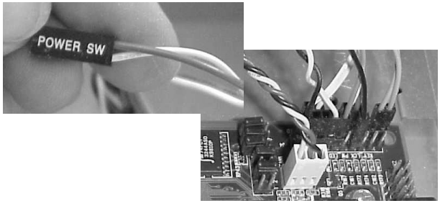
Attaching Case Wires
Match colored wires from case to pins on motherboard

Slide 21
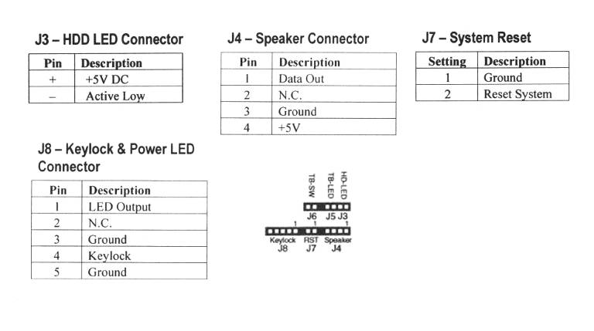
Use Motherboard Manual for Reference

Slide 22
Connecting I/O Ports
Necessary only on AT systems
Attach ports to back of case
Attach ribbon cables from ports to motherboard
Red stripe = pin 1

Slide 23
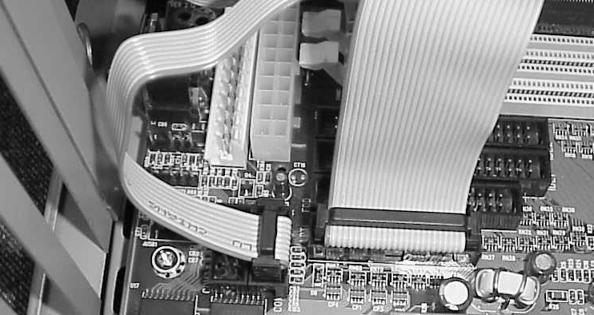
Connecting I/O Ports

Slide 24
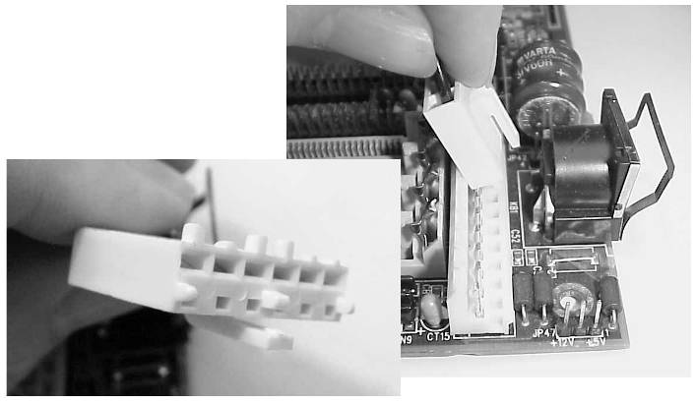
Connecting the Power Supply
AT: P8 and P9, black wires together

Slide 25
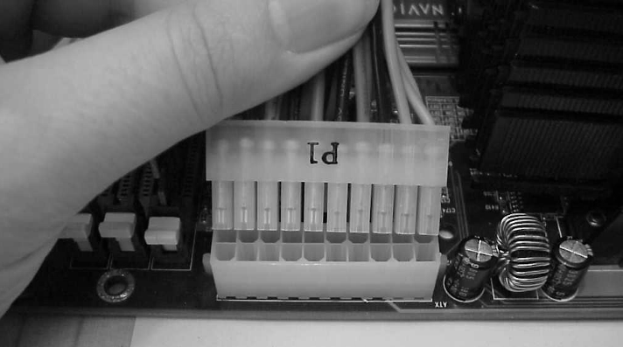
Connecting the Power Supply
ATX: Single Connector

Slide 26
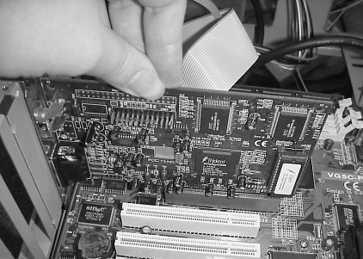
Installing Video Card
Insert into open expansion slot
Match chosen slot with type of video card
  AGP
  PCI Express (only on newer systems)
  Regular PCI

Slide 27
Testing the Installation
Connect a monitor
Turn on power
Evaluate on-screen messages
Any text onscreen means basic components are working

Slide 28
Troubleshooting
No power supply fan
  No power
  Bad power supply
  Not connected
Beep codes
  RAM or CPU not installed correctly
  Bad RAM
  Wrong type of RAM

Slide 29
No Onscreen Text
Bad or incorrectly installed RAM or CPU
Bad or incorrectly installed video card
No monitor power, or not connected
Other installed component is causing a problem (drive, expansion card)

